Slide 1
THz Ryegrass Hydration Measurement
Mar-15 Report
Reporter: Jialu Xing
Supervisor: Dominik Vogt

Slide 2
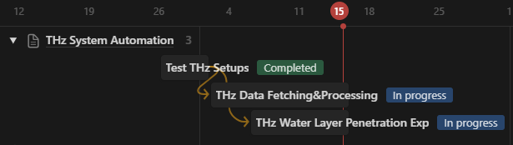
Overall Progress

Slide 3
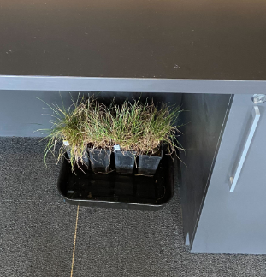
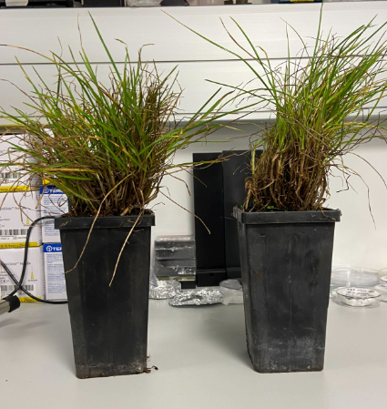
Test THz Set Up
Plants for test use

Slide 4
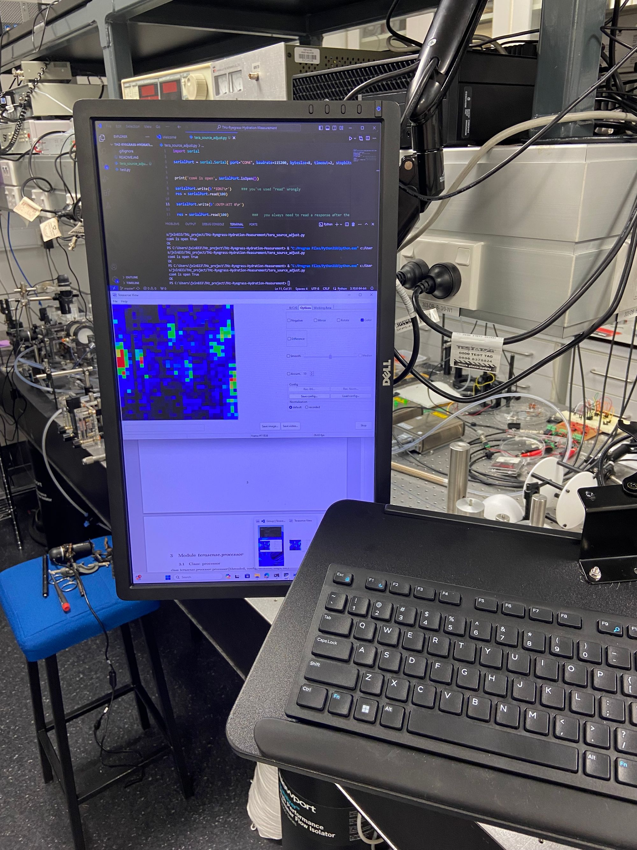
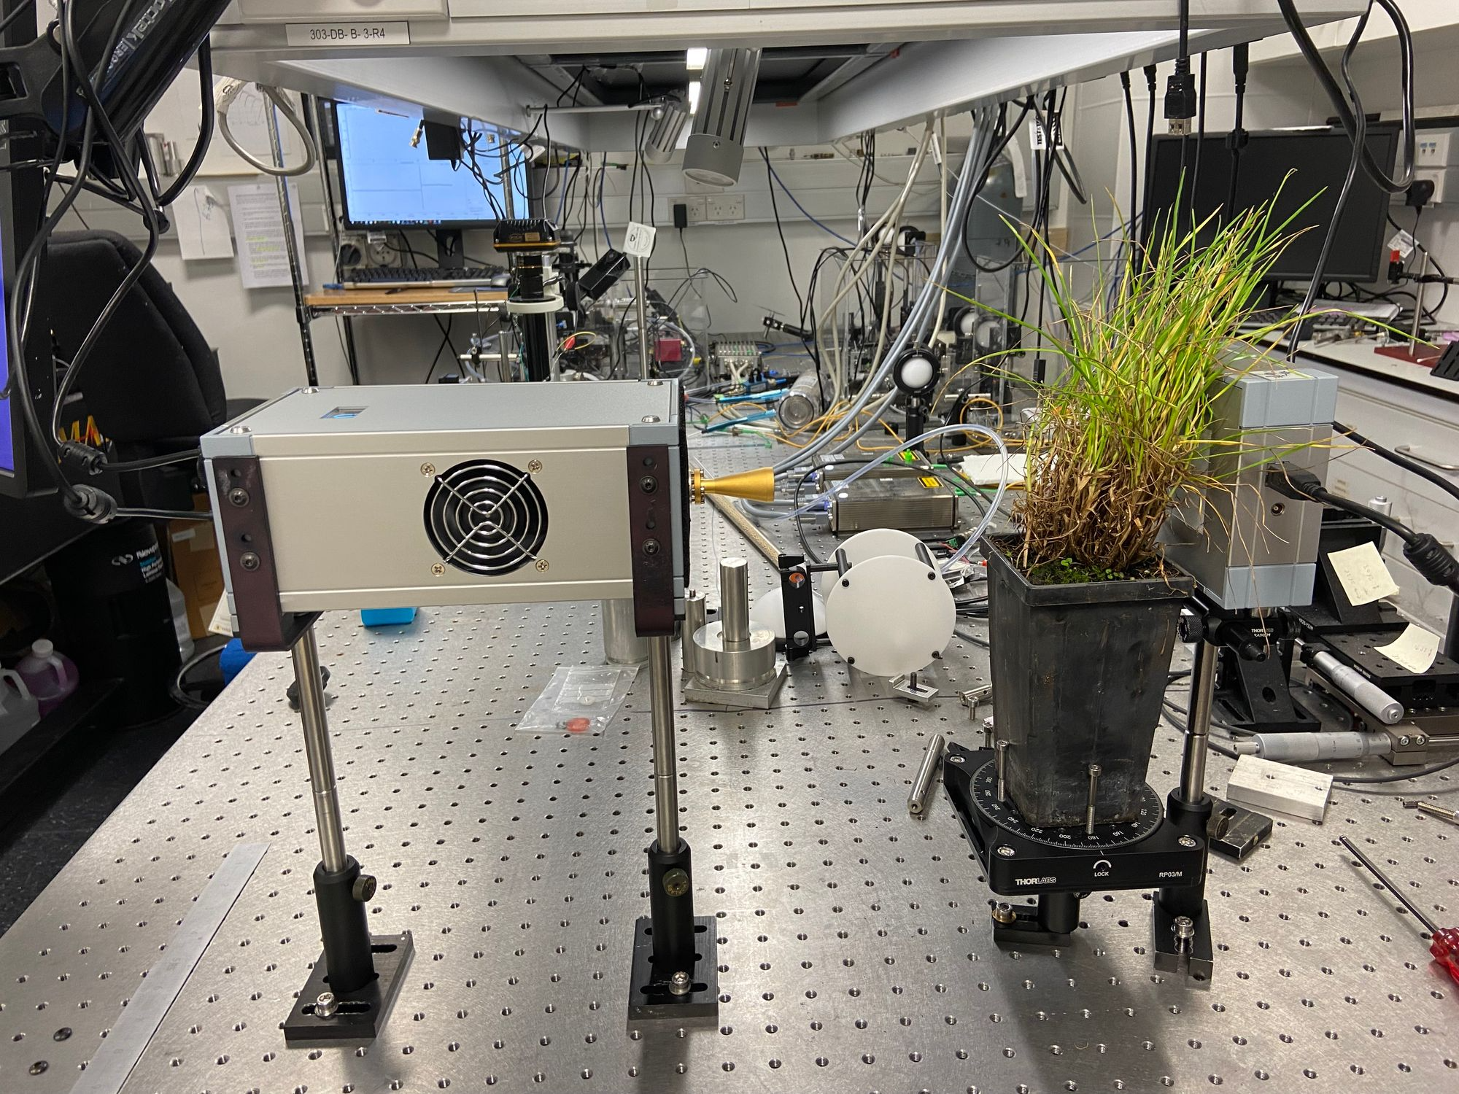
Test THz Set Up
Lab THz system set up

Slide 5
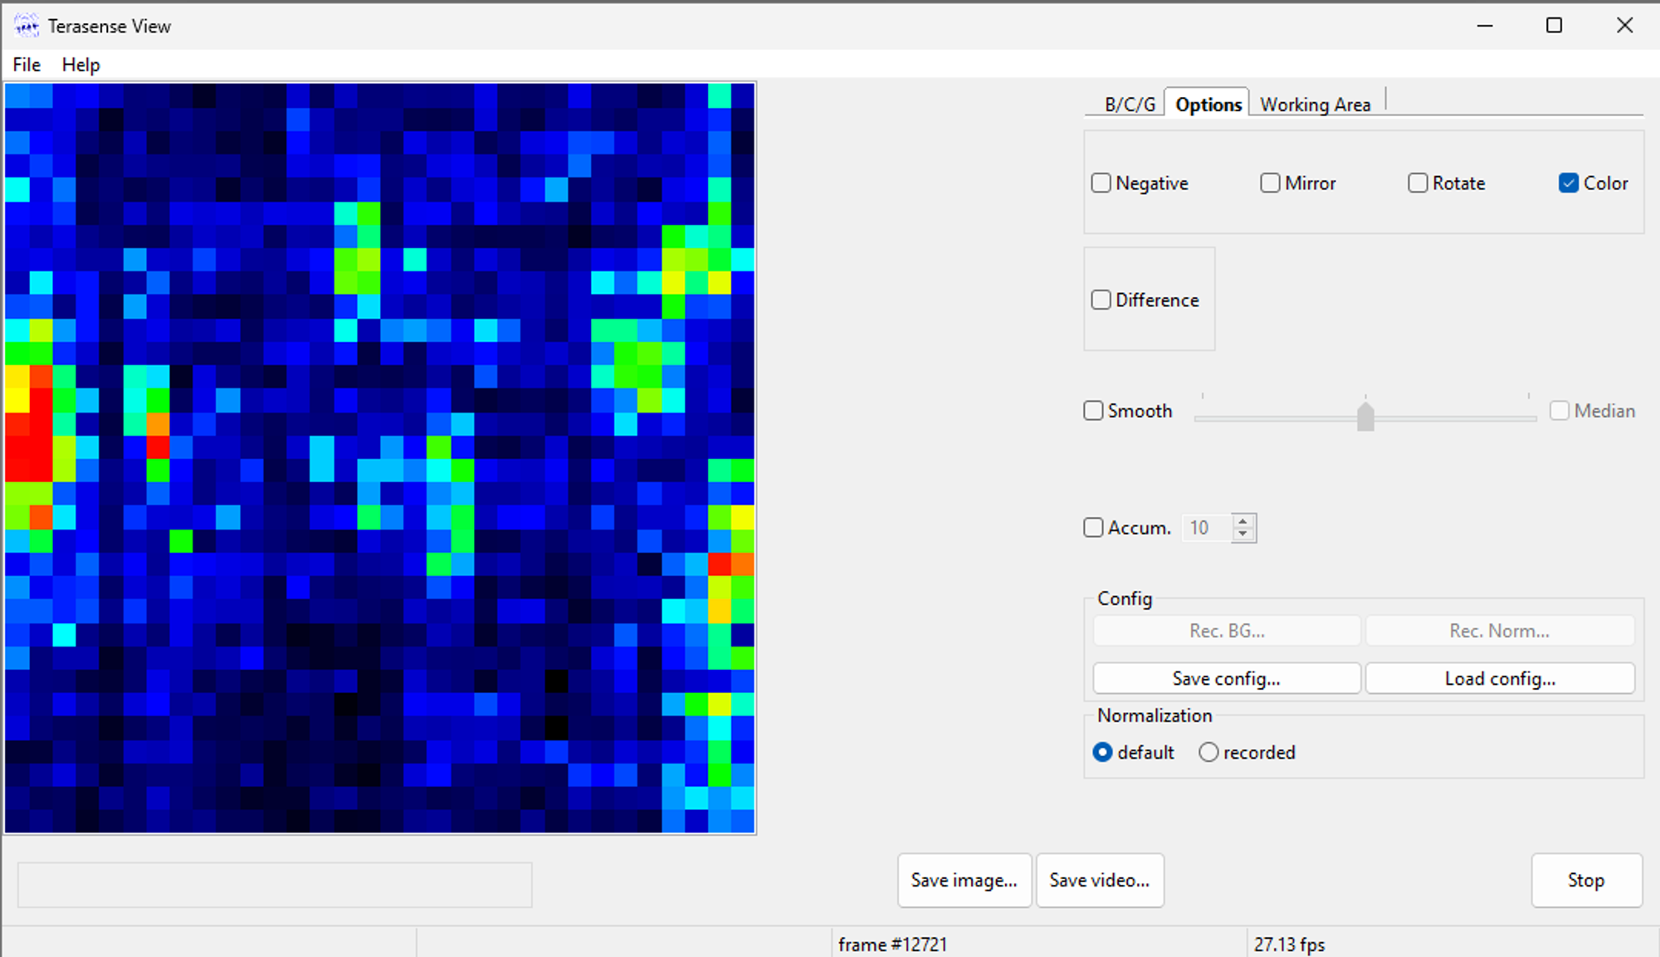
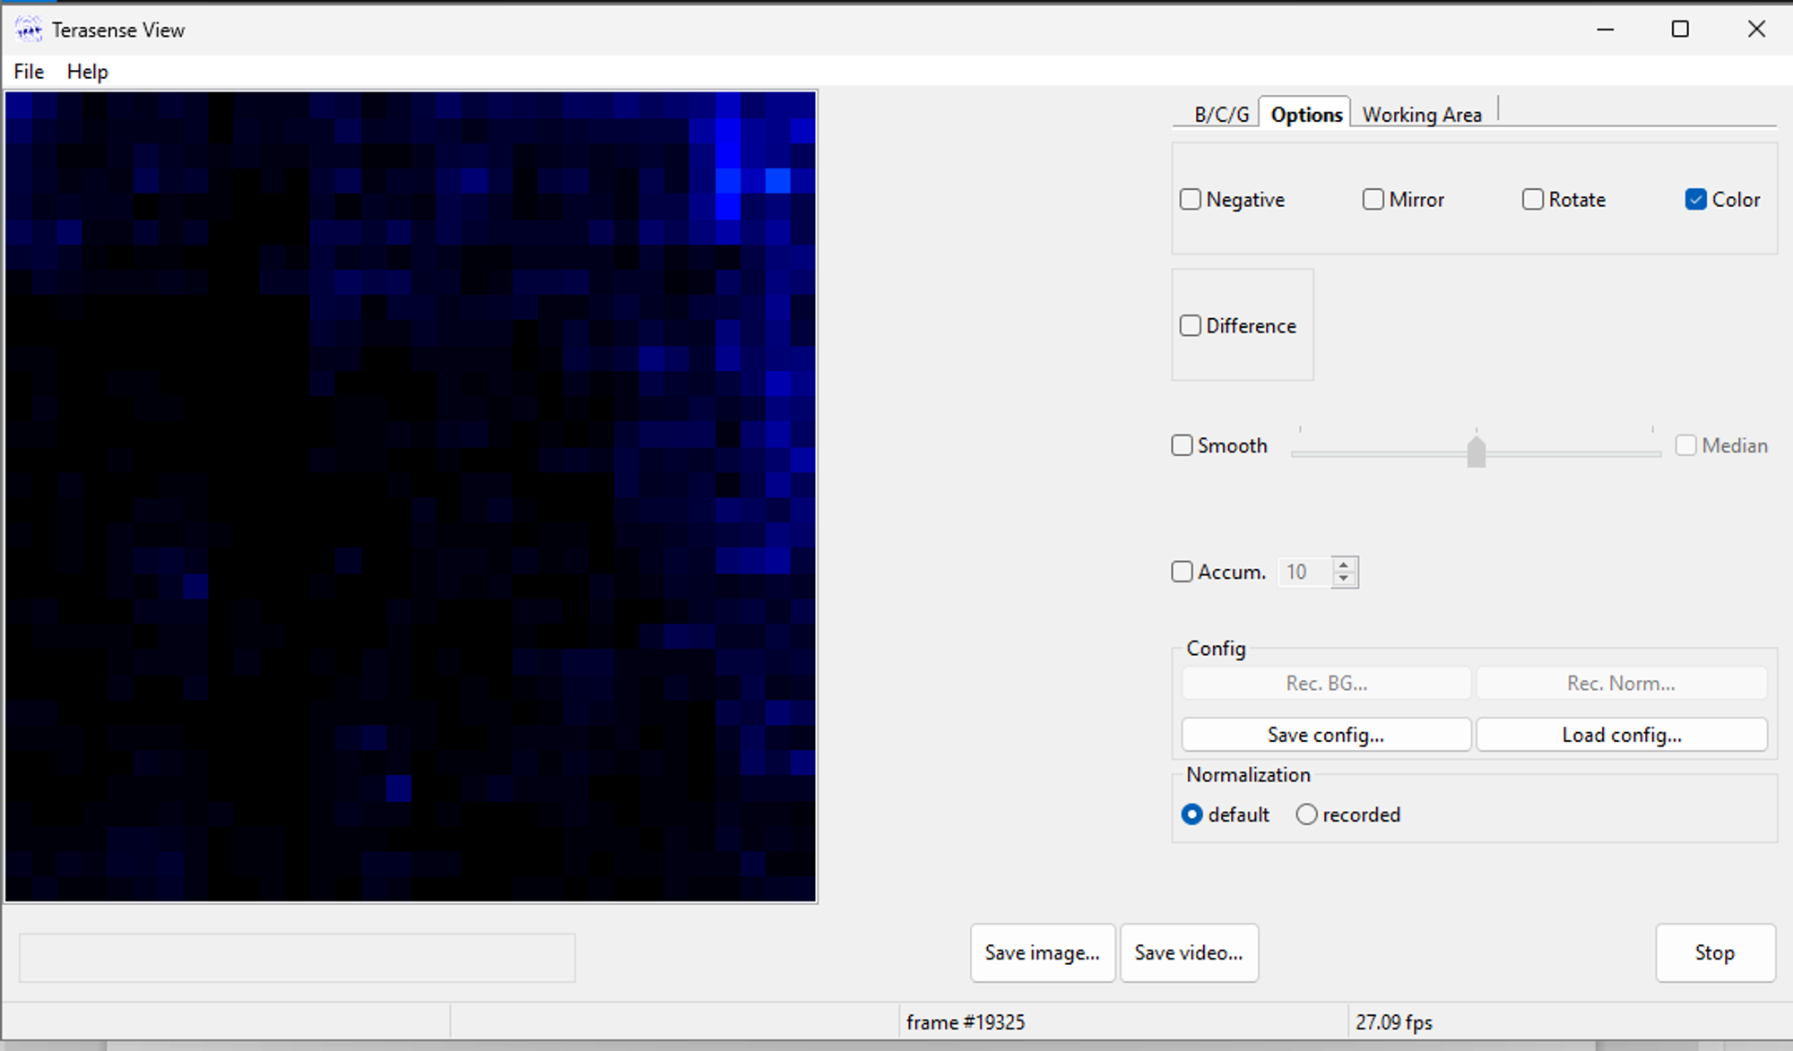
Test THz Set Up
Image from the software of sparse plants
Image from the software of thick plants
Image from the software of spares plants provides a clearer view

Slide 6
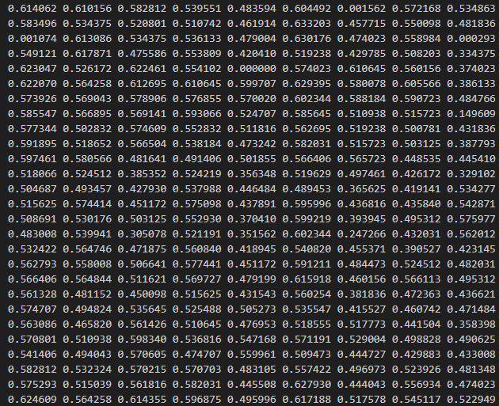
THz Data Fetching & Processing
Understand the Data
Data Format: one-channel grayscale data range [0,1] in a 32x32 n-dimensional array

Slide 7
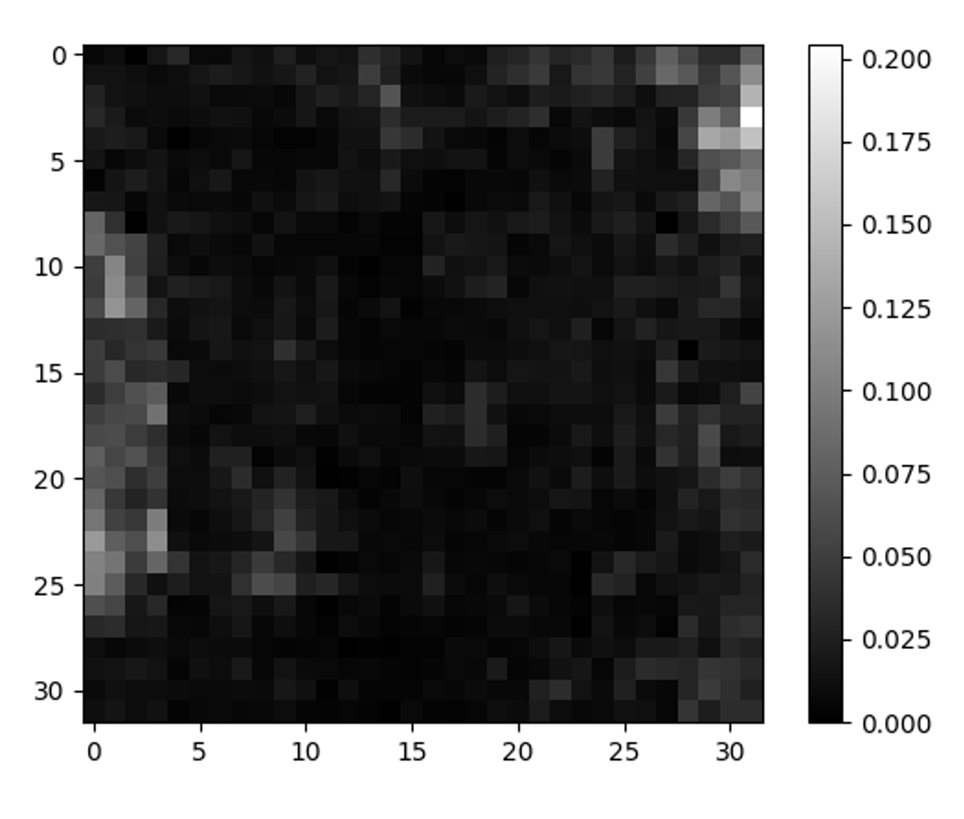
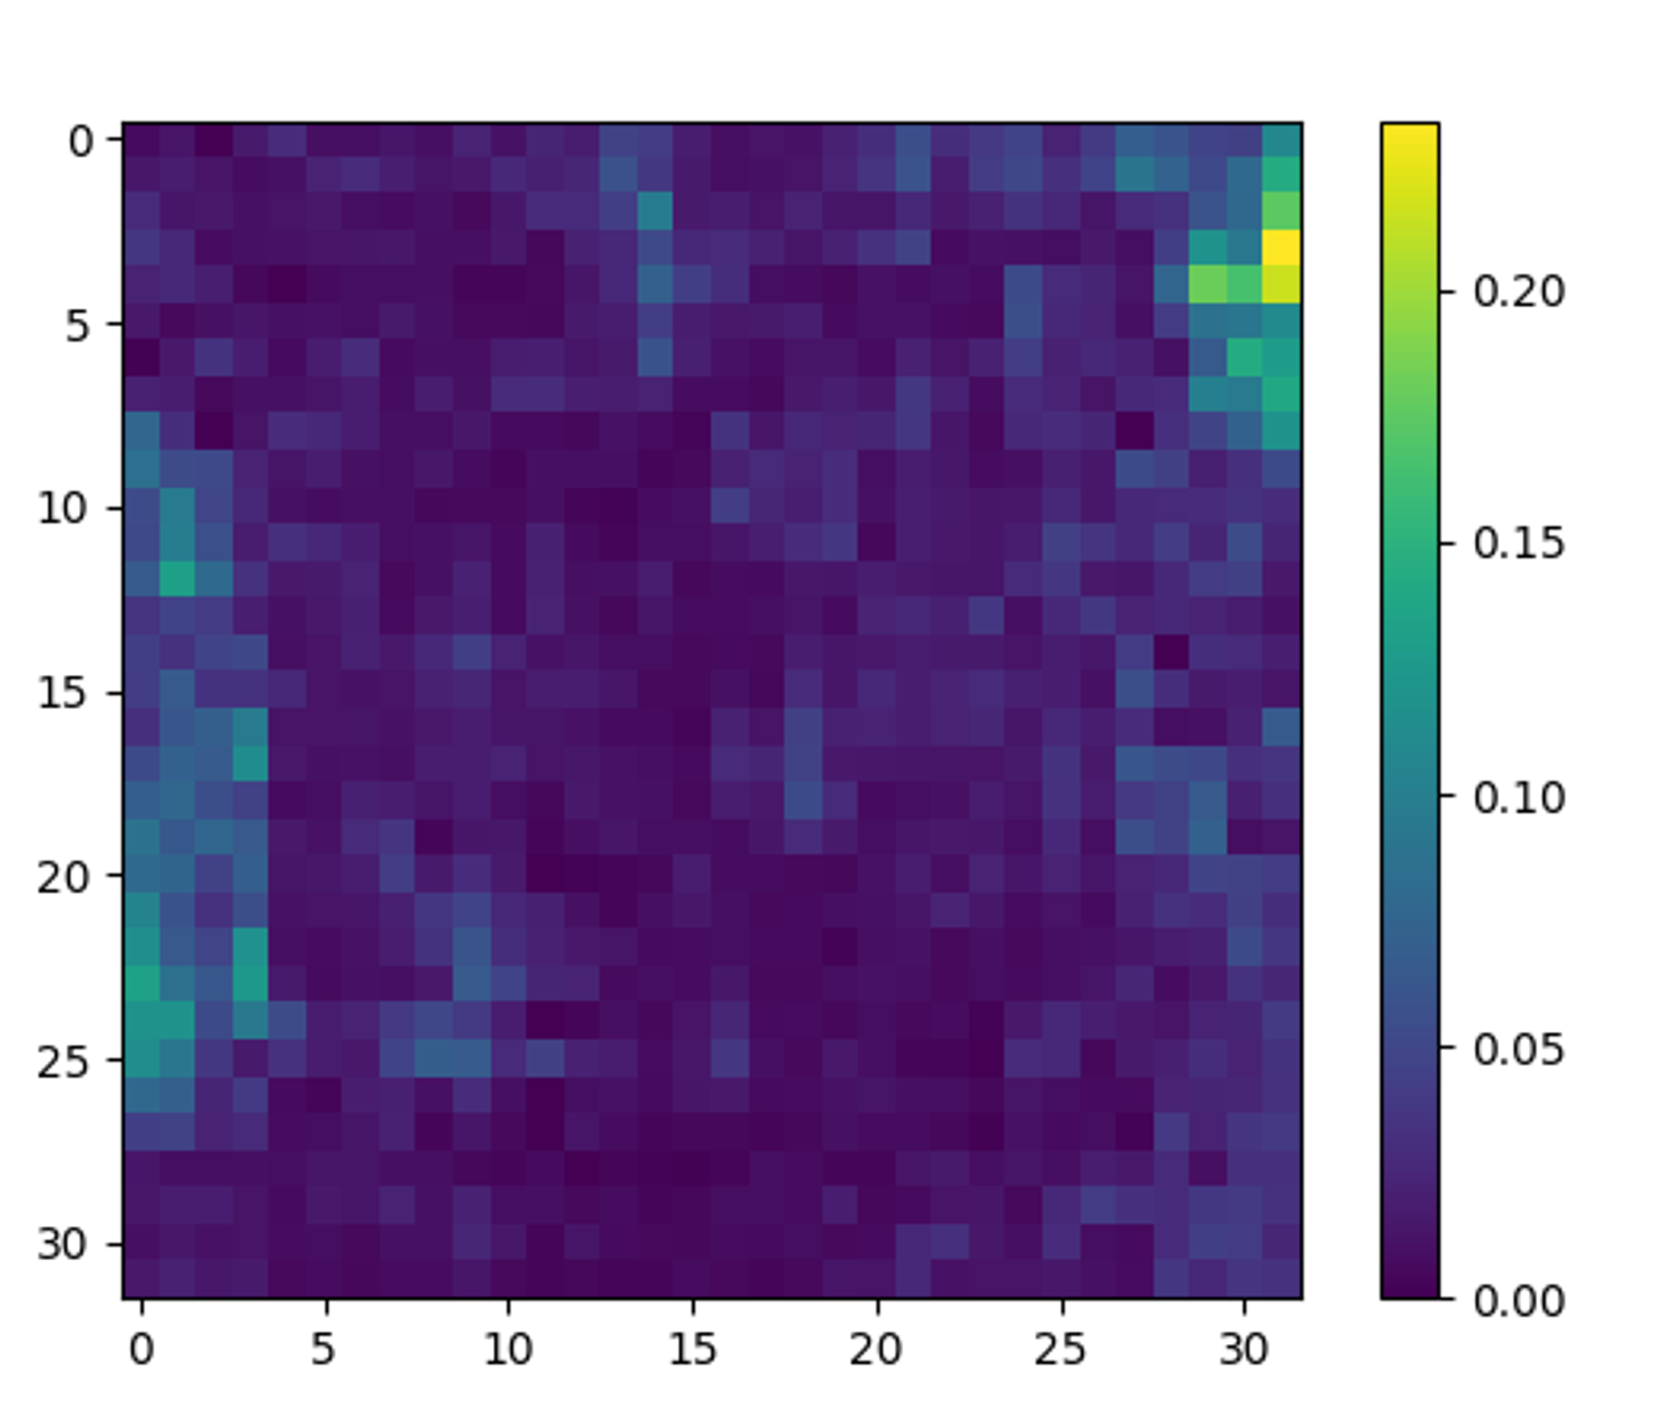
THz Data Fetching & Processing
Understand the Data
Data Format: one-channel grayscale data range [0,1] in a 32x32 n-dimensional array
Grey-scale image
Color-map image

Slide 8
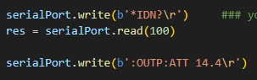
THz Data Fetching & Processing
Adjust The Attenuation Of The Source
Manually
Non-Auto
Auto-adjust the attenuation based on the data(pixel value) fetch from the camera API

Slide 9
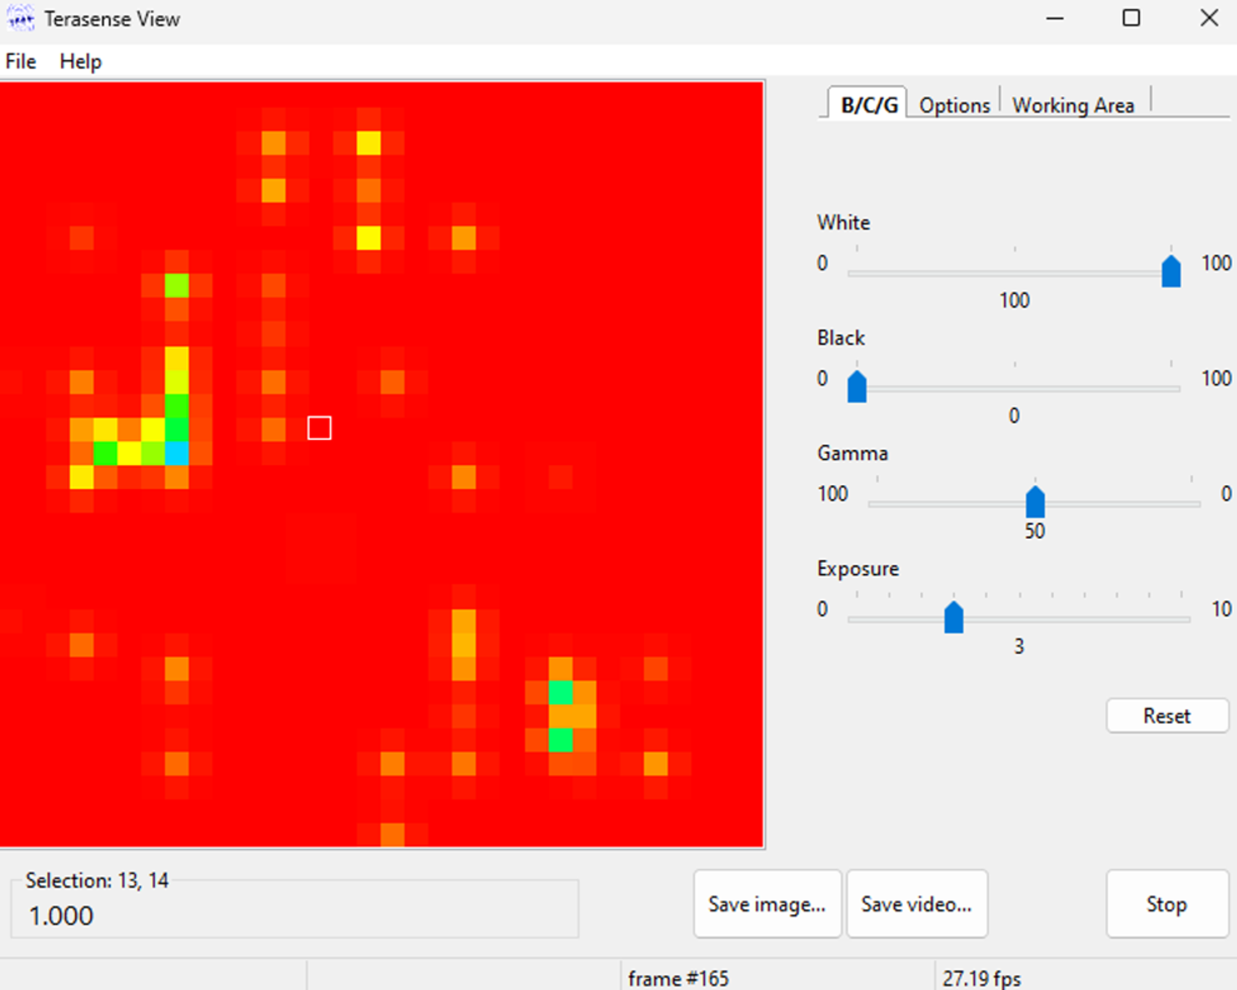
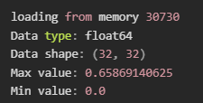
THz Data Fetching & Processing
Pixel Value Data Issue
Data in the software
Data fetched with API

Slide 10
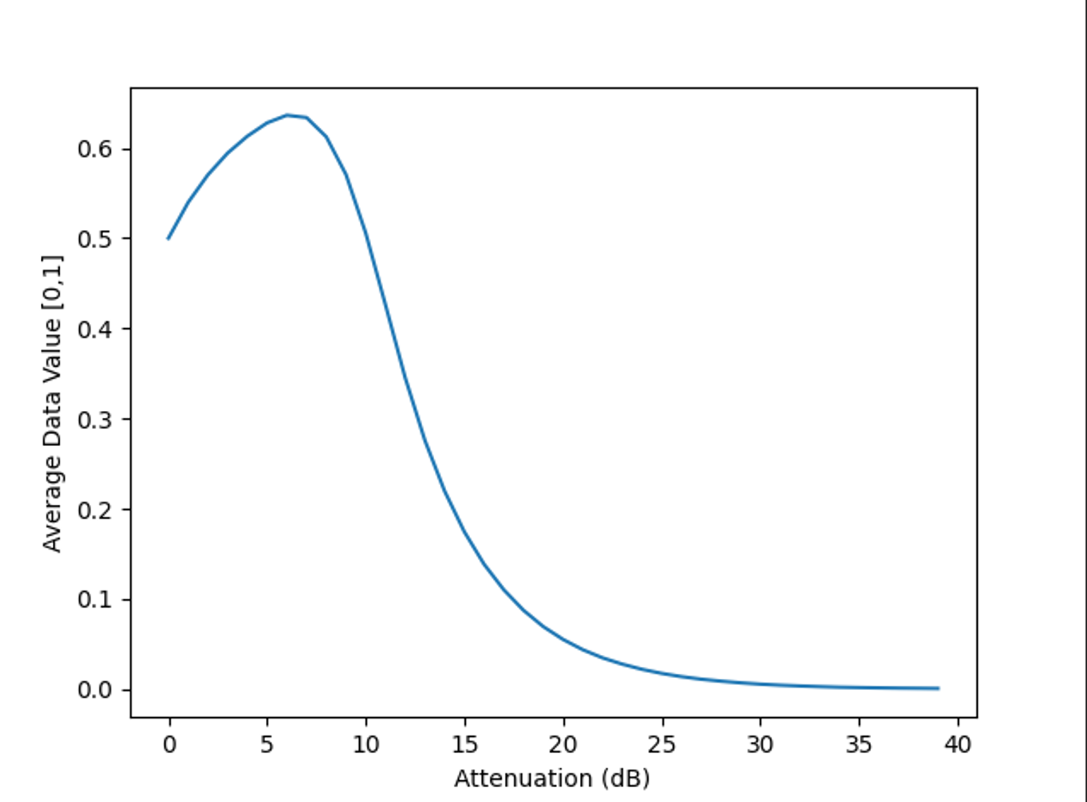
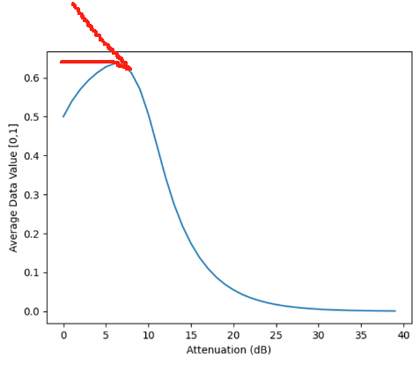
THz Data Fetching & Processing
Pixel Value Data Issue
The average pixel value against the source attenuation
Figure we got
Expected figure

Slide 11
THz Data Fetching & Processing
Pixel Value Data Issue
What the API data represents and how it correlates with the pixel values shown in the software?
why the pixel value initially increases with increasing attenuation?

Slide 12
THz Water Layer Penetration Exp
Aim
Refining our methodology for assessing the hydration status of plants
Reference: Empty cuvette
Dry leaves
Sample: Cuvette with water
Watered leaves

Slide 13
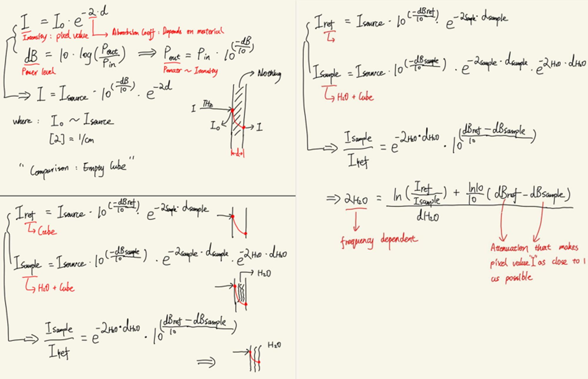
THz Water Layer Penetration Exp
Thesis

Slide 14
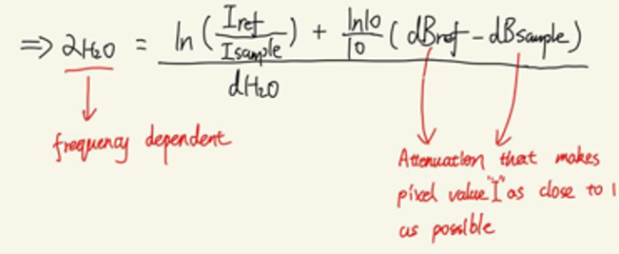
THz Water Layer Penetration Exp
Thesis
I_ref: Intensity ~ pixel value
dB: Attenuation
d_H20: 0.2/0.5(mm)
Frequency: 0.1(THz)
Compare tested alpha_H20 with the one in the literature
If they are identical
Our methodology for assessing the hydration status of plants is correct

Slide 15
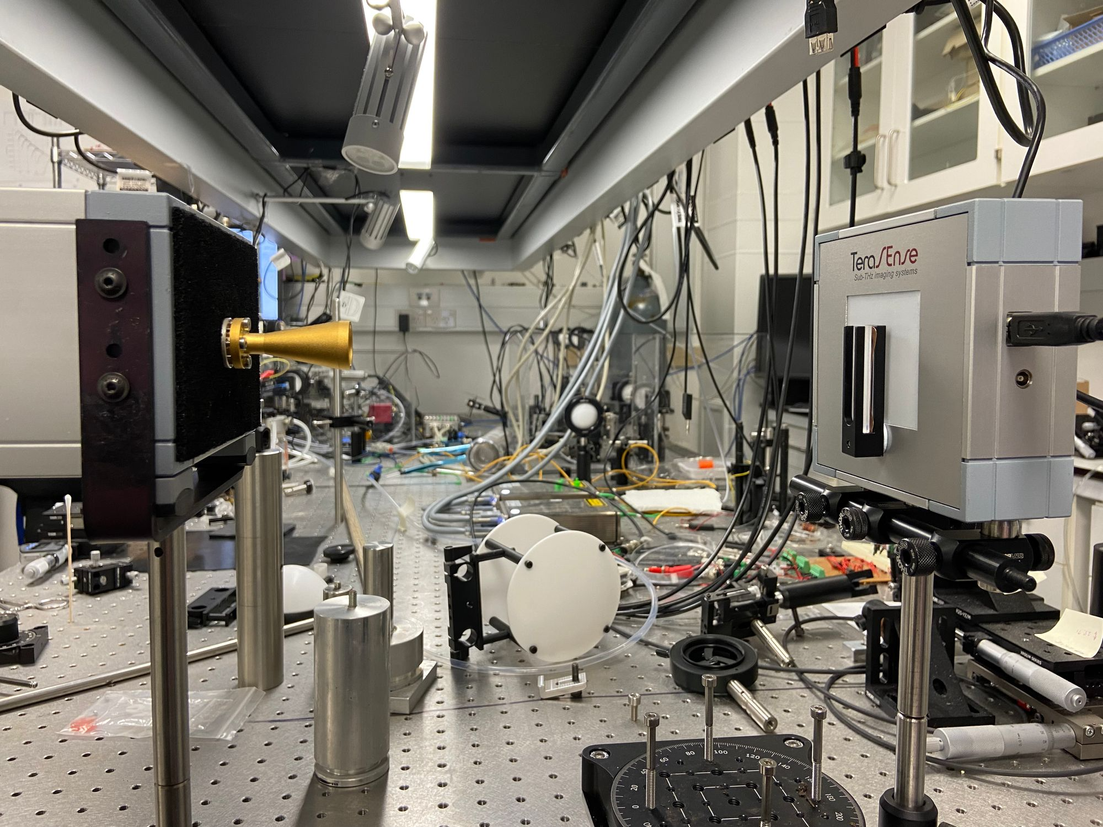
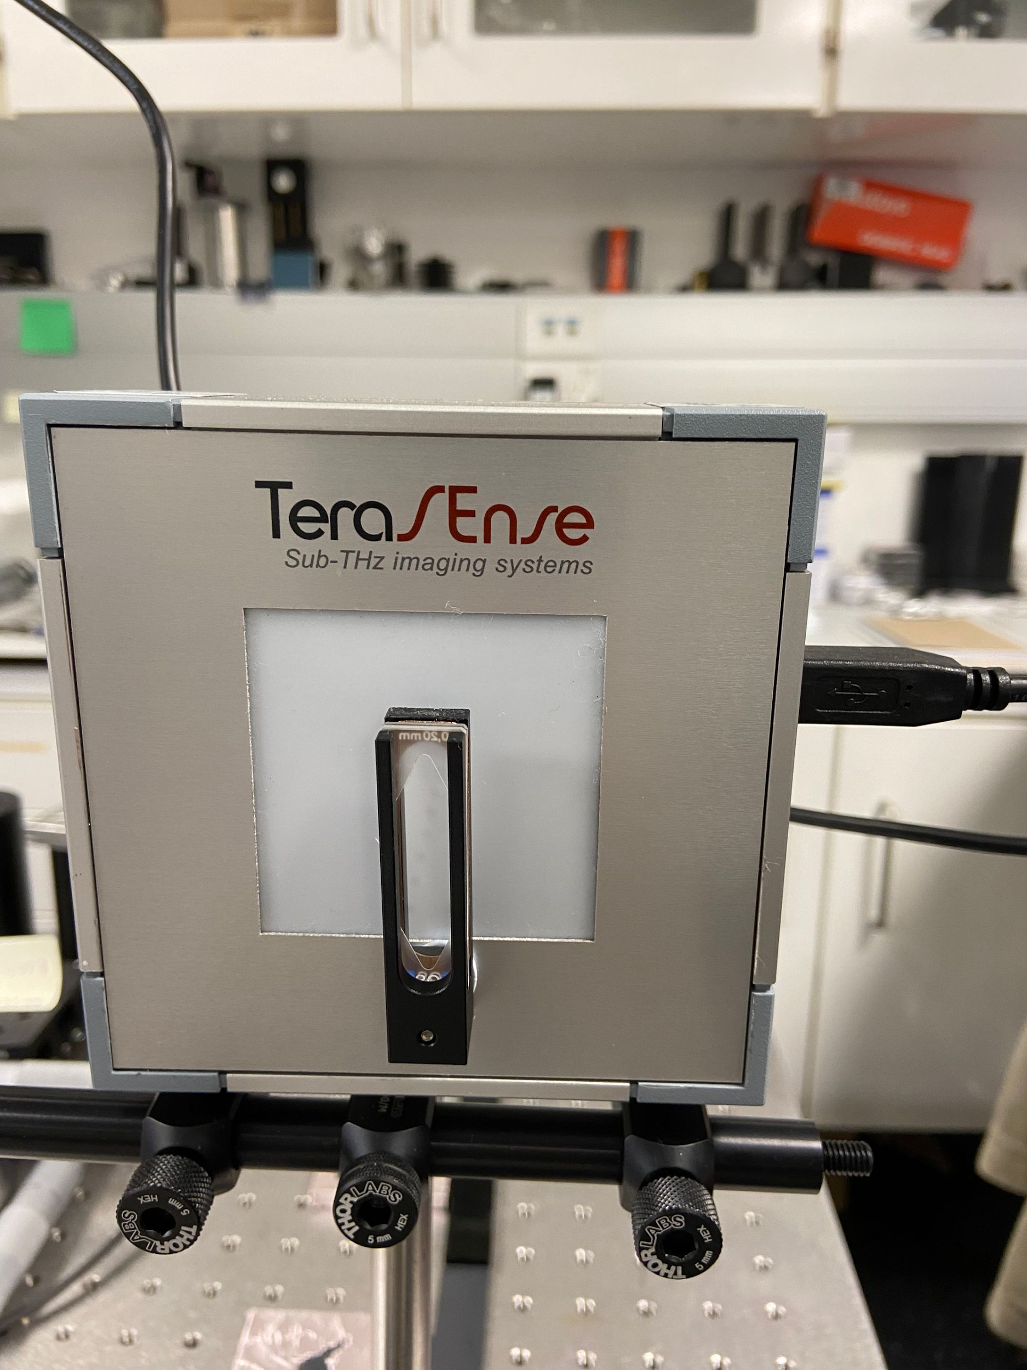
THz Water Layer Penetration Exp
Experiment Set Up

Slide 16
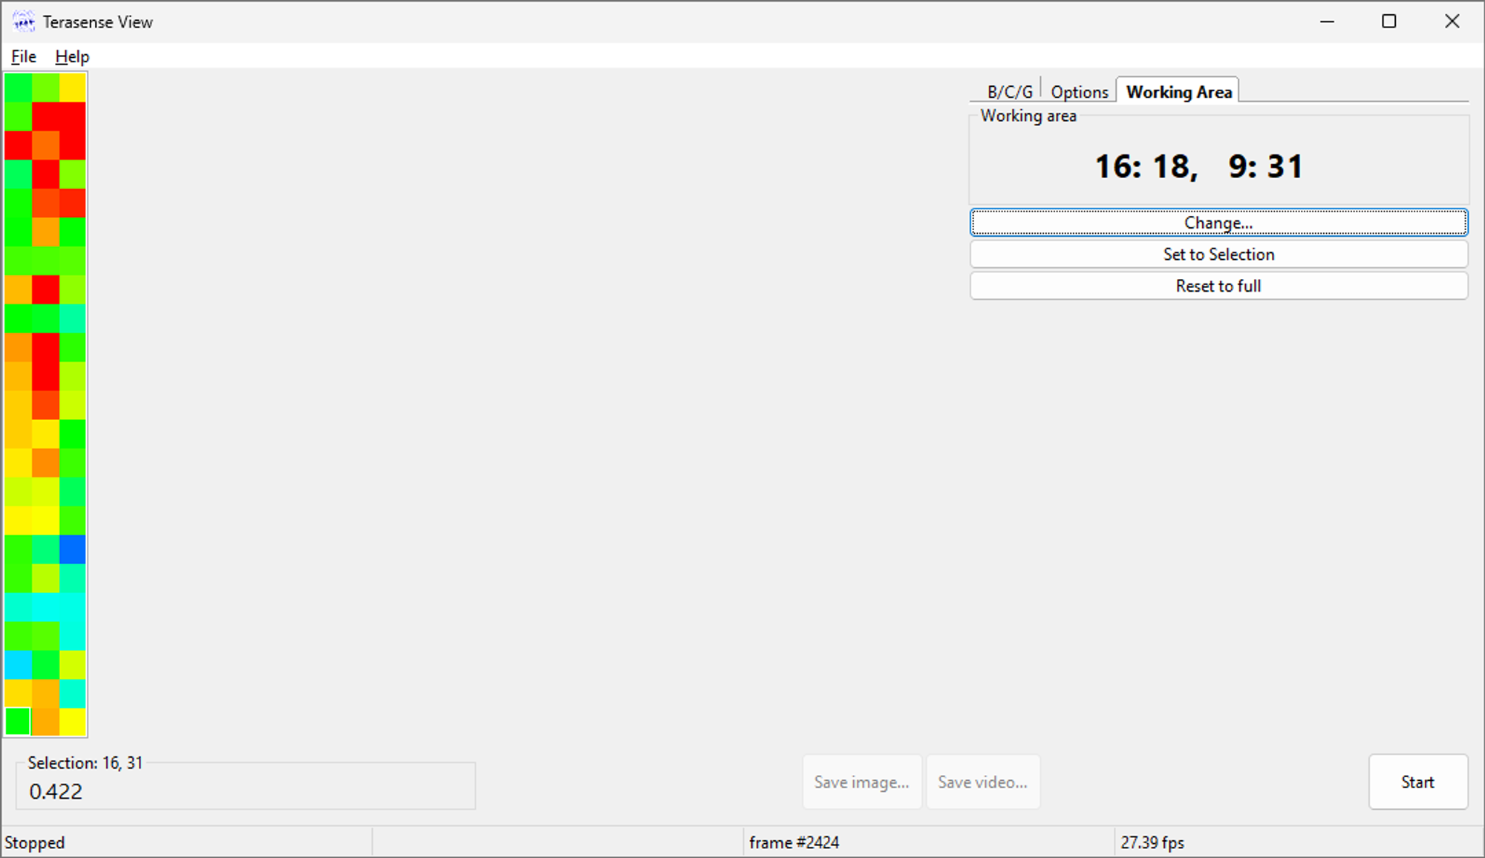
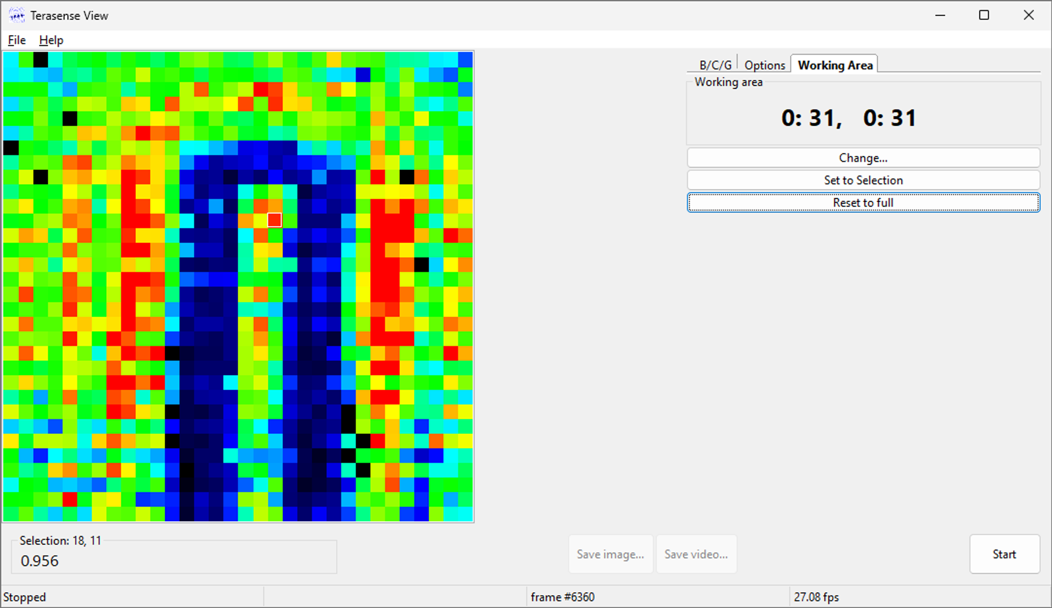
THz Water Layer Penetration Exp
Experiment Set Up
Working area

Slide 17
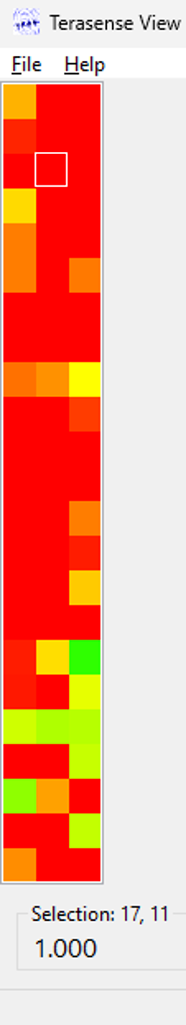
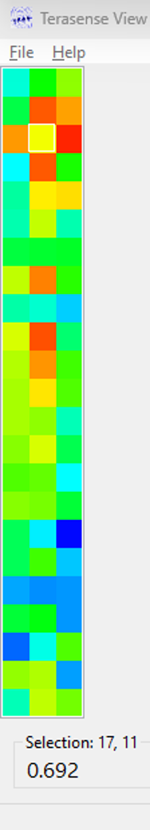
THz Water Layer Penetration Exp
Reference group
Adjust attenuation till just NOT saturated
Record present data
Repeat the same process on the sample group
Calculate alpha_H20

Slide 18
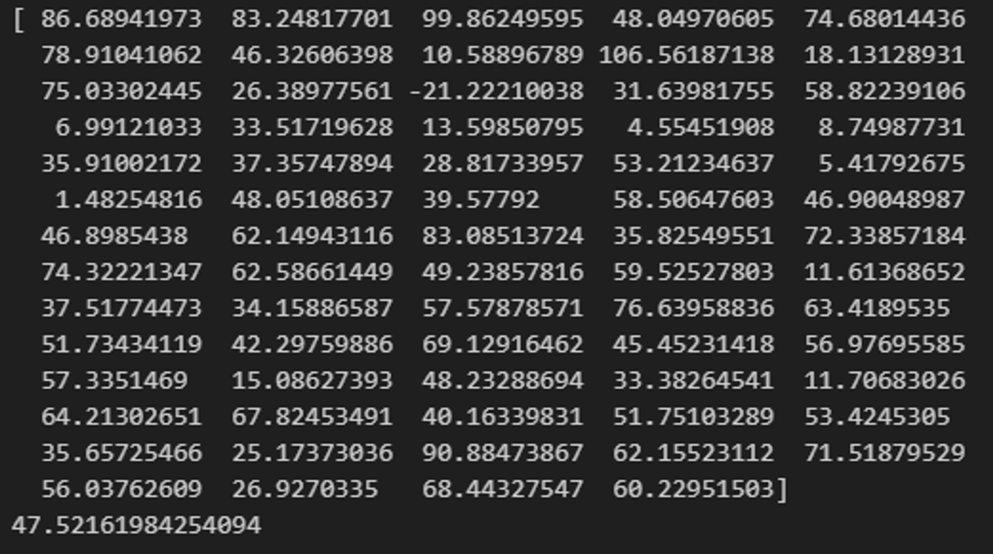
THz Water Layer Penetration Exp
Experiment Result
Expected: around 85
Actual: around 47
alpha_H20

Slide 19
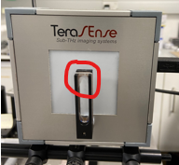
THz Water Layer Penetration Exp
Experiment Result
Cuvette is not exactly put at the middle of the source beam.
Non accurate data collected due to the non-rectangle shape of the cuvette.
Source affected by the cuvette holder
Background compensation required.

Slide 20
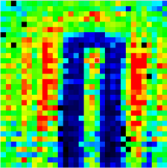
THz Water Layer Penetration Exp
Experiment Result
Cuvette is not exactly put at the middle of the source beam.
Non accurate data collected due to the non-rectangle shape of the cuvette.
Source affected by the cuvette holder
Background compensation required.
Cuvette
Water

Slide 21
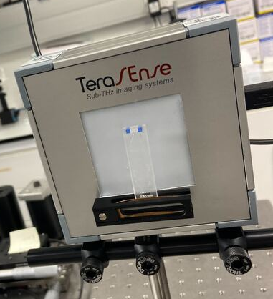
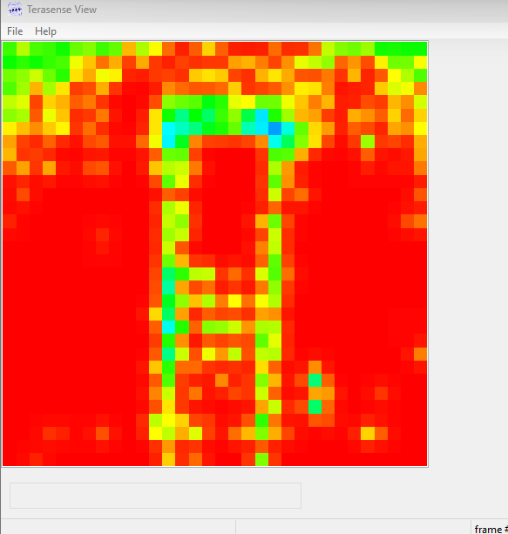
THz Water Layer Penetration Exp
Experiment Result
Cuvette is not exactly put at the middle of the source beam.
Non accurate data collected due to the non-rectangle shape of the cuvette.
Source affected by the cuvette holder
Background compensation required.

Slide 22
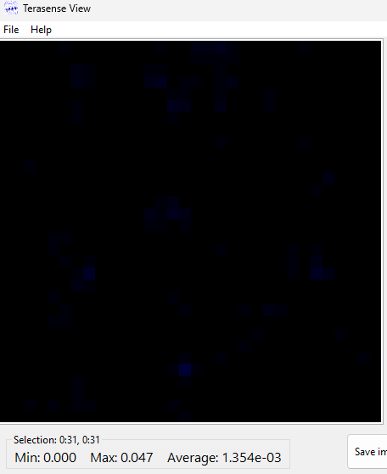
THz Water Layer Penetration Exp
Experiment Result
Cuvette is not exactly put at the middle of the source beam.
Non accurate data collected due to the non-rectangle shape of the cuvette.
Source affected by the cuvette holder
Background compensation required.

Slide 23
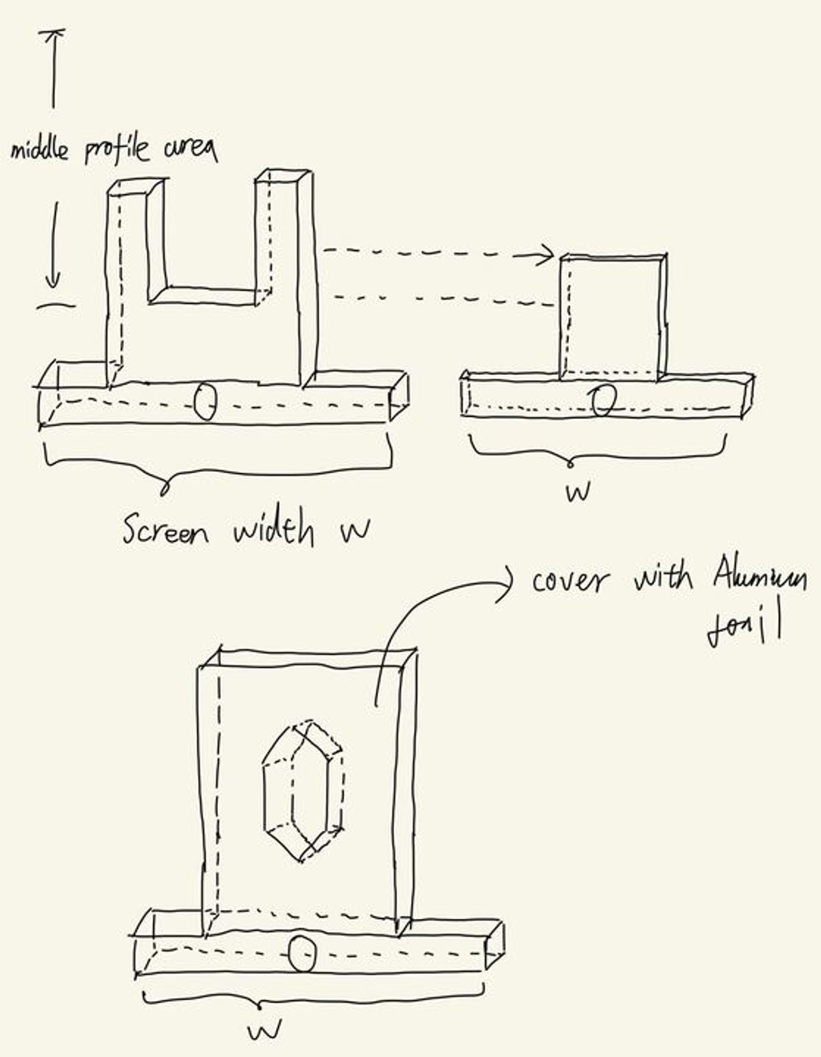
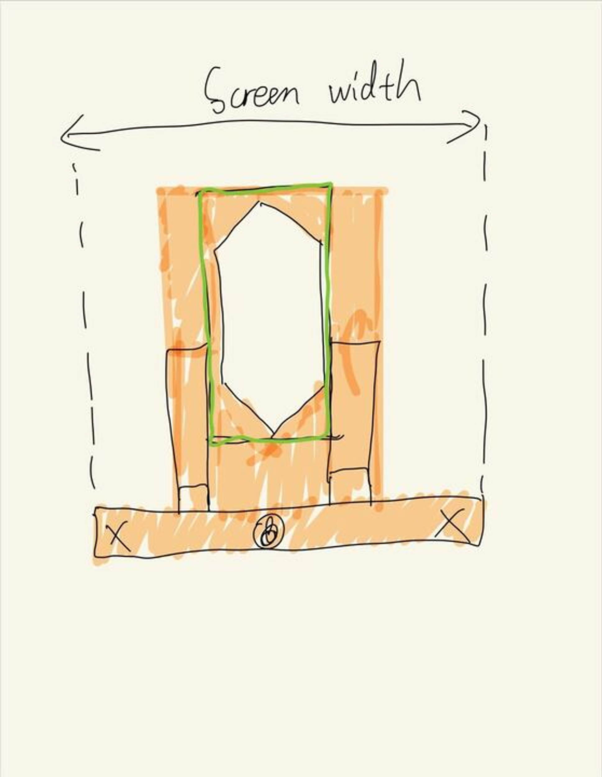
THz Water Layer Penetration Exp
Modification
Make a new holder that can only show the water part of the cuvette

Slide 24
THz Water Layer Penetration Exp
Modification
Make a new holder that can only show the water part of the cuvette
Conduct background and beam compensation before doing tests.

Slide 25
Outlook
Complete water layer experiment with new approaches.
Wait for reply from Terasense and complete the building of data fetching & processing auto-script.
Perform initial scans with ryegrass.

Slide 26
Thank you!

